Slide 1
Ethical Problem Solving Techniques

Slide 2
ANALYSIS OF ISSUES IN ETHICAL PROBLEM
A first step in solving any ethical problem is to completely understand all of the issues involved.
The issues involved in understanding ethical problems can be split into three categories: factual, conceptual, and moral.
Understanding these issues helps to put an ethical problem in the proper framework and often helps point the way to a solution.

Slide 3
Types of Issues in Ethical Problem Solving
Factual issues involve what is actually known about a case—i.e., what the facts are.
Although this concept seems straightforward, the facts of a particular case are not always clear and may be controversial. An example of facts that are not necessarily clear can be found in the controversy in contemporary society regarding abortion rights.
In engineering, there are controversies over facts as well. For example, global warming is of great concern to society as we continue to emit greenhouse gases into the atmosphere. Greenhouse gases, such as carbon dioxide, trap heat in the atmosphere. This is thought by climate scientists to lead to a generalized warming of the atmosphere as emissions from automobiles and industrial plants increase the carbon dioxide concentration in the atmosphere.
This issue is of great importance to engineers since they might be required to design new products or redesign old ones to comply with stricter environmental standards if this warming effect indeed proves to be a problem.

Slide 4
Conceptual issues have to do with the meaning or applicability of an idea. In engineering ethics, this might mean defining what constitutes a bribe as opposed to an acceptable gift, or determining whether certain business information is proprietary.
Once the factual and conceptual issues have been resolved, at least to the extent possible, all that remains is to determine which moral principle is applicable to the situation. In our example of a “gift” offered by a sales representative, once it is determined whether it is simply a gift or is really a bribe, then the appropriate action is obvious. If we determine that it is indeed a bribe, then it cannot ethically be accepted.

Slide 5
Application to a Case Study: Paradyne Computers
In 1980, Paradyne, a computer company, bid to supply the Social Security Administration (SSA) with new computer systems.
factual issues. The request for proposals clearly specified that only existing systems would be considered. Paradyne did not have any such system running and had never tested the operating system on the product they actually proposed to sell to the SSA. The employment of a former SSA worker by Paradyne to help lobby SSA for the contract is also clear.
The conceptual issues involve whether bidding to provide an off-the-shelf product when the actual product is only in the planning stages is lying or is an acceptable business practice. Is placing a Paradyne label over the real manufacturer’s label deceptive? Does lobbying your former employer on behalf of your current employer constitute a conflict of interest?

Slide 6
Paradyne asserted that it had done nothing wrong and was simply engaging in common business practices.
The moral issues then include the following: Is lying an acceptable business practice? Is it alright to be deceptive if doing so allows your company to get a contract?
The answers to these questions are obvious: Lying and deceit are no more acceptable in your business life than in your personal life. So, if conceptually we decide that Paradyne’s practices were deceptive, then our analysis indicates that their actions were unethical.

Slide 7
LINE DRAWING
The line-drawing technique that will be described in this section is especially useful for situations in which the applicable moral principles are clear, but there seems to be a great deal of “gray area” about which ethical principle applies.
At one end is placed the “positive paradigm,” At the other end, the “negative paradigm,” In between is placed the problem under consideration,
Those examples that more closely conform to the positive paradigm are placed near it, and examples closer to the negative paradigm are placed near that paradigm.
Let’s illustrate this technique using a hypothetical situation. Our company would like to dispose of a slightly toxic waste by dumping it into a local lake from which a nearby town gets its drinking water. How can we determine if this practice is acceptable? Let’s start by defining the problem and the positive and negative paradigms.

Slide 8
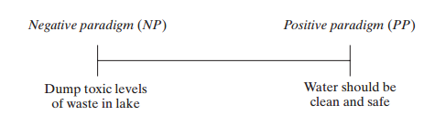
Problem: It is proposed that our company dispose of a slightly hazardous waste by dumping it into a lake. A nearby town takes its drinking water supply from this lake. Our research shows that with the amount of waste we plan to put into the lake, the average concentration of the waste in the lake will be 5 parts per million (ppm). The EPA limit for this material has been set at 10 ppm. At the 5-ppm level, we expect no health problems, and consumers would not be able to detect the compound in their drinking water.
Positive paradigm: The water supply for the town should be clean and safe.
Negative paradigm: Toxic levels of waste are put into the lake.

Slide 9
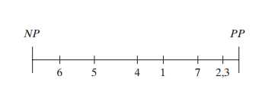
1.The company dumps the chemical into the lake. At 5 ppm, the chemical will be harmless, but the town’s water will have an unusual taste.
2.The chemical can be effectively removed by the town’s existing water-treatment system.
3.The chemical can be removed by the town with new equipment that will be purchased by the company.
4.The chemical can be removed by the town with new equipment for which the taxpayer will pay.
5.Occasionally, exposure to the chemical can make people feel ill, but this only lasts for an hour and is rare.
6.At 5 ppm, some people can get fairly sick, but the sickness only lasts a week, and there is no long-term harm.
7.Equipment can be installed at the plant to further reduce the waste level to 1 ppm.

Slide 10
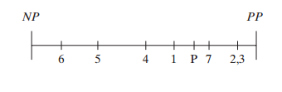
Now let’s complete the exercise by denoting our problem by a “P” and inserting it at the appropriate place along the line. As with the previous examples, placement of the problem along the line is somewhat subjective.
It should be noted that although this action seems ethically acceptable, there are many other considerations that might be factored into the final decision. For example, there are political aspects that should also be considered.
Good community relations might dictate that another solution should be pursued instead.
The company also might want to avoid the lengthy amount of time required to obtain a permit for the dumping and the oversight by various government agencies.
Pitfalls, line drawing can easily be used to prove that something is right when it is actually wrong. Line drawing is only effective if it is used objectively and honestly.
There is a long history of the improper use of this technique.

Slide 11
Application of Line Drawing to the Pentium Chip Case
In 1994–95, it was discovered and widely reported that the latest version of the Intel Pentium chip had flaws. At first, Intel sought to hide this information, but later came around to a policy of offering consumers chips in which the flaw had been corrected.
1.There is a flaw in the chip, but it truly is undetectable and won’t affect any customer’s applications.
2.There are flaws in the chip, the customer is informed of them, but no help is offered.
3.A warning label says that the chip should not be used for certain applications.
4.Recall notices are sent out, and all flawed chips are replaced.
5.Replacement chips are offered only if the customer notices the problem.

Slide 12
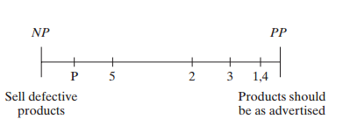
Where does our situation—there is a f aw, customers aren’t informed, and the magnitude of the problem is minimized—fit on this line? One possible analysis is the following:
According to this line-drawing analysis, the approach taken by Intel in this case wasn’t the best ethical choice

Slide 13
FLOW CHARTING
In engineering ethics, flow charting will be helpful for analyzing a variety of cases, especially those in which there is a sequence of events to be considered or a series of consequences that flows from each decision.
As with the line-drawing technique described in the previous section, there is no unique flow chart that is applicable to a given problem.
In fact, different flow charts can be used to emphasize different aspects of the same problem. As with line drawing, it will be essential to be as objective as possible and to approach f ow charting honestly. Otherwise, it will be possible to draw any conclusion you want, even one that is clearly wrong.
We can illustrate this technique by applying a simple flow chart to a disaster that happened at Union Carbide’s plant in Bhopal, India, where MIC, a toxic substance, was mixed with water, creating toxic fumes.

Slide 14
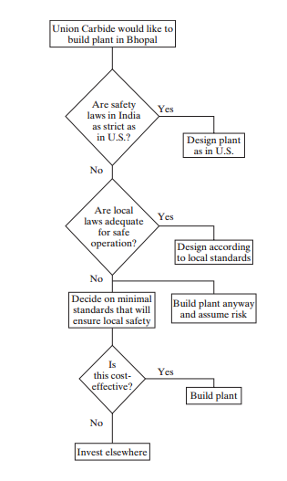
Application of a simple flow chart to the Bhopal case, emphasizing potential decisions made during consideration of locating a plant in India

Slide 15
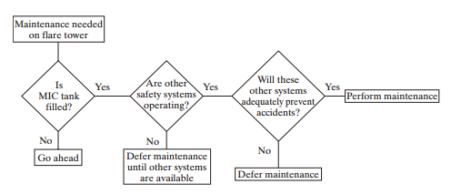
An alternative f ow chart for the Bhopal case, emphasizing decisions made when considering deactivating the f are tower for maintenance.

Slide 16
CONFLICT PROBLEMS
An area of ethical problem solving that we will frequently encounter in this book relates to problems that present us with a choice between two conflicting moral values, each of which seems to be correct. How do we make the correct choice in this situation?
Conflict problems can be solved in three ways
Often, there are conflicting moral choices, but one is obviously more significant than the other. For example, protecting the health and safety of the public is more important than your duty to your employer. In this type of case, the resolution of the conflict involves an easy choice.
A second solution is sometimes called the “creative middle way”. This solution is an attempt at some kind of a compromise that will work for everyone. The emphasis here should be on the word “creative,” because it takes a great deal of creativity to find a middle ground that is acceptable to everyone and a great deal of diplomacy to sell it to everyone.

Slide 17
An example of a creative middle ground would be that rather than dumping a toxic waste into a local lake, one finds ways to redesign the production process to minimize the amount of waste products produced, finds ways to pretreat the waste to minimize the toxicity, or offers to pay for and install the equipment at the municipal water system necessary to treat the water to remove this chemical before it is sent to homes. Obviously, no one will be completely satisfied with these alternatives, since redesigns and pretreatment cost money and take time. Some people will not be satisfied with even a minimized dumping of toxics.
Finally, when there is no easy choice and attempts to find a middle ground are not successful, all that is left is to make the hard choice. Sometimes, you have to bite the bullet and make the best choice possible with the information available at the time. Frequently, you must rely on “gut feelings” for which path is the correct one.

Slide 18
Challenger explosion, focusing on the dilemma faced by the engineering manager, Bob.
The conflict was clear: There was an unknown probability that the shuttle would explode, perhaps killing all aboard.
On the other hand, Bob had a responsibility to his company and the people who worked for him. There were consequences of postponing the launch, potentially leading to the loss of future contracts from NASA.
The risk to the lives of the astronauts is too great and far outweighs any other considerations. It is impossible to balance jobs against lives. After all, most people who lose their jobs will be able to find other employment.
The creative middle ground might involve delaying the launch until later in the day, when the temperature will have warmed up. Of course, this option might not be possible for many reasons associated with the timing of rocket launches and the successful completion of the planned missions.
Instead, perhaps, the astronauts could be informed of the engineer’s concerns and be allowed to make the choice whether to launch or not. If a risk is informed and a choice is made by those taking the risk, it somewhat relieves the company of the responsibility if an accident occurs.
Bob chose to risk the launch, perhaps because the data were ambiguous. He might also have wanted to help ensure the future health of the shuttle program and to save the jobs of the Thiokol workers. As we know, his gamble didn’t pay off. The shuttle did explode, causing the deaths of the astronauts and leading to lengthy delays in the shuttle program.

Slide 19
AN APPLICATION OF PROBLEM-SOLVING METHODS: BRIBERY/ACCEPTANCE OF GIFTS
One of the many gray areas of engineering ethics is the acceptance of gifts from vendors or the offering of gifts to customers to secure business.
First, bribery corrupts our free-market economic system and is anticompetitive. Unlike the practice of buying the best product at the best price, bribery does not reward the most efficient producer. One can argue the virtues or vices of the free-market economy, but it is the system under which our economy operates, and anything that subverts this system is unfair and unethical.
Second, bribery is a sellout to the rich. Bribery corrupts justice and public policy by allowing rich people to make all the rules. In business, it guarantees that only large, powerful corporations will survive, since they are more capable of providing bribes. A small start-up company doesn’t have the resources to compete in an environment where expensive favors are required to secure business.
Finally, bribery treats people as commodities that can be bought and sold. This practice is degrading to us as human beings and corrupts both the buyer and the seller

Slide 20
When Is a Gift a Bribe?
Gifts of nominal value, such as coffee mugs or calendars with a vendor’s logo and phone number on it, are really just an advertising tool. Generally, there is no problem with accepting these types of items.
Dining with a customer or a supplier is also an acceptable practice, especially if everyone pays his or her own way. It is important from the point of view of both suppliers and customers that good relations be maintained so that good service can be provided.
Social interaction, such as eating together, often facilitates the type of close and successful interactions required by both sides. However, when meals or gifts are no longer of low cost and the expense of these items is not shared equally, the possibility for abuse becomes large.

Slide 21
Examples of Gifts vs. Bribes
During a sales visit, a sales representative offers you a coffee mug with his company’s name and logo on it. The value of the mug is five dollars. Can you accept this item? Does the answer to this question change if this item is a $350 crystal bowl with the name of the company engraved on it? How about if there is no engraving on it?
Your meeting with a sales representative is running into the lunch hour. She invites you to go out for lunch. You go to a fast-food restaurant and pay for your own lunch. Is this practice acceptable? Does the answer to this question change if you go to an expensive French restaurant? If she pays for lunch?
A sales representative from whom you often purchase asks if you would like to play tennis with him this weekend at one of the local municipal courts. Should you go? Is the answer to this question different if the match is at an exclusive local club to which he belongs? What if he pays the club’s guest fee for you?
A company sales representative would like you to attend a one-day sales seminar in Cleveland. Your company will pay for your trip. Should you go? How about if the meeting is in Maui? What if the sales representative’s company is going to pay for you to go? What if your family is invited as well?
Keep in mind that gifts accepted even after the purchase of something from a company might be a bribe directed at securing future sales from you or might be aimed at engineers at other companies.

